Slide 1




HackOrbit 2025
CODE CATALYST

Slide 2

THEME
Artificial Intelligence and Machine Learning
🚩 PROBLEM STATEMENT
"Preparing for technical interviews is often inefficient, with most candidates relying on static question banks, videos, or peer sessions that don’t reflect real interview pressure. These methods lack interactivity, personalization, and actionable feedback — leaving candidates underprepared and lacking confidence. There’s a clear need for a smarter, more realistic, and scalable solution to help candidates practice effectively and improve their performance."

Slide 3
✅ Proposed Solution: AI-Powered Mock Interview Platform 🤖💬
Our project offers an intelligent mock interview platform that uses artificial intelligence to simulate real-time technical interviews. By integrating AI interviewer agents 🤖 that can conduct domain-specific question rounds, the platform provides a realistic and interactive experience for job seekers. After each session, users receive instant feedback 📊 on their performance, including metrics like confidence, clarity, and correctness. The system also tracks user progress over time 📈, helping candidates identify their strengths and improve continuously. Built with Next.js, TypeScript, and Firebase ⚙️, the app is secure, scalable, and responsive across devices, delivering a seamless experience for learners and job applicants preparing for high-stakes interviews.

Slide 4
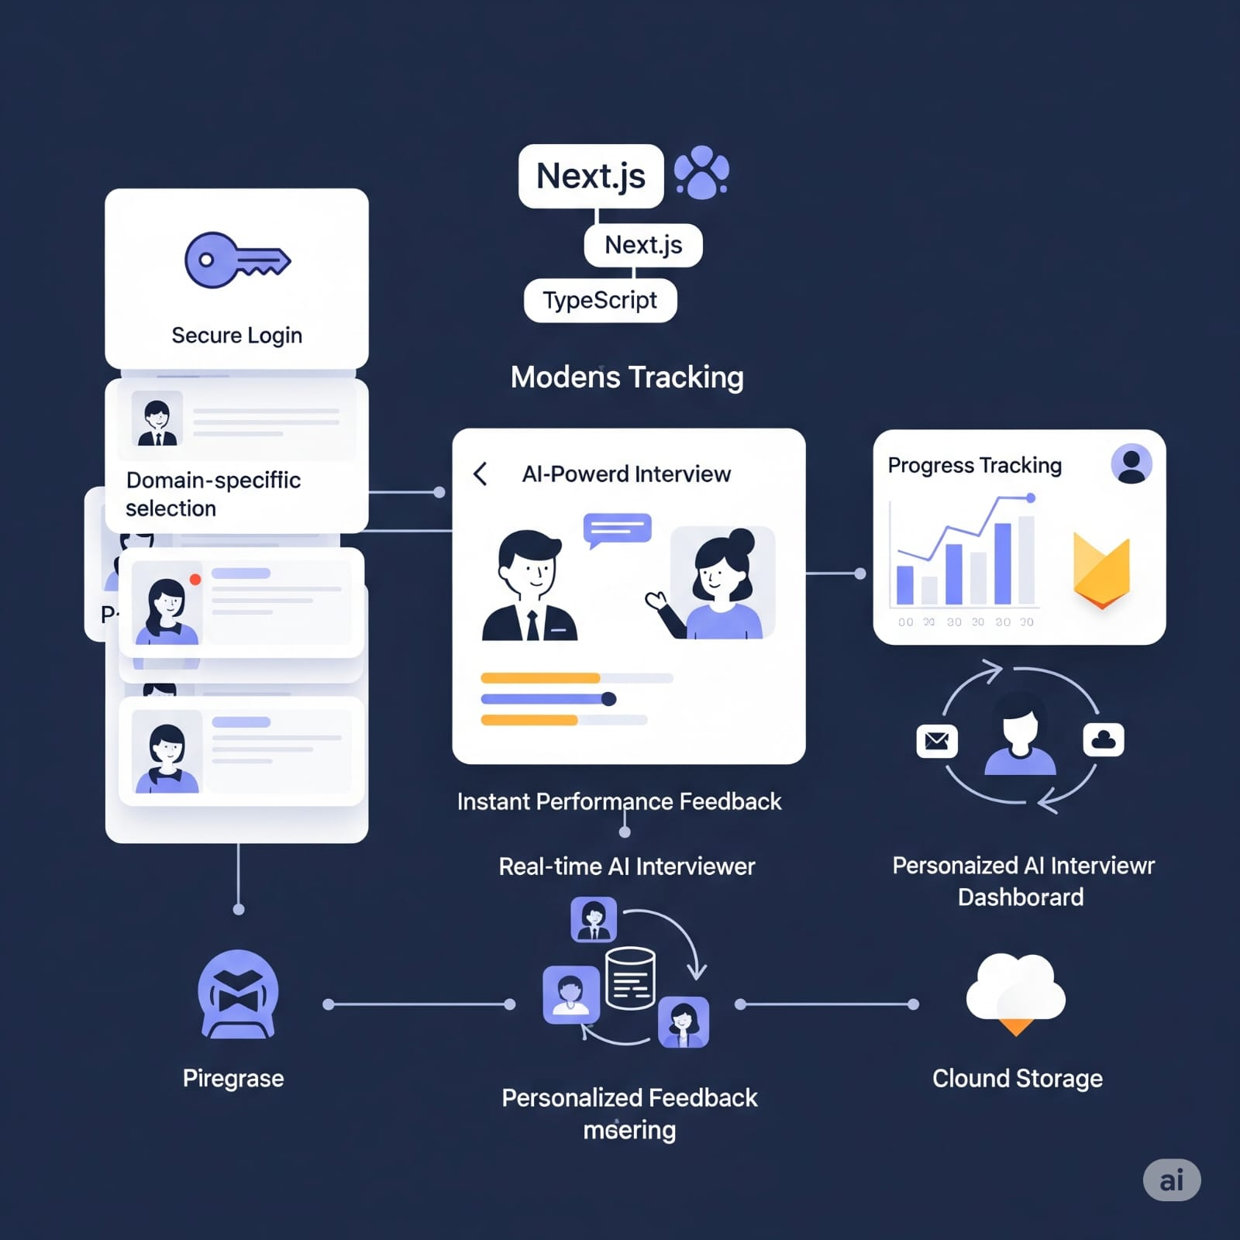

Slide 5
🔄 App Workflow (Step-by-Step)
🔐 Secure Login – User authentication for safe access.
🧠 Domain Selection – Choose tech stack (e.g., React, Next.js).
🤖 AI-Powered Interview – Real-time simulation with virtual interviewer.
📊 Instant Feedback – Evaluate performance on clarity, confidence, and correctness.
📈 Progress Tracking – Dashboard to view improvement over time.
💡 Personalized Feedback – Insights tailored to user’s performance.
☁️ Cloud Storage – Secure storage of sessions and results.

Slide 6
🚀 Features & Novelty of the App
🔐 Secure Login System – Enables protected user access through modern authentication.
🧠 Domain-Specific Interview Practice – Users choose interviews based on technologies like React, Node.js, or Fintech.
🤖 AI-Powered Interview Simulation – Engaging, real-time sessions with intelligent virtual interviewers.
📊 Instant Feedback Generation – Evaluates user responses based on clarity, correctness, and confidence.
📈 Progress Tracking Dashboard – Visualizes performance trends and growth over multiple sessions.
☁️ Cloud-Based Data Management – Firebase securely stores sessions, feedback, and user history.
💻 Modern & Responsive UI – Clean, cross-platform design optimized for all devices.
🧩 Personalized Learning Loop – Feedback adapts based on user performance, helping targeted improvement.
🧪 Real-World Simulation – Mimics live interview pressure better than static question banks.
⚙️ Scalable Architecture – Built with Next.js, TypeScript, and Firebase to support real users at scale.

Slide 7
⚠️ Drawbacks & Showstopper
🧠 Limited AI Depth – AI logic is semi-structured, not fully conversational.
🔁 Static Feedback – Evaluation lacks nuance and personalization.
📶 No Offline Mode – Requires stable internet connection.
📦 Limited Domains – Only supports a few technical areas.
⚠️ Showstopper: Feedback quality drops if prompts or user responses are unclear.

Slide 8
CODE CATYLYST
JAGRITI DWIVEDI
dwivedijagriti88@gmail.com
BHUKYA KEERTHANA
921010keerthana@gmail.com
GUGULOTHU PRANAYASHEELA
pranayasheela702@gmail.com

Slide 9
Thank you

